Slide 1
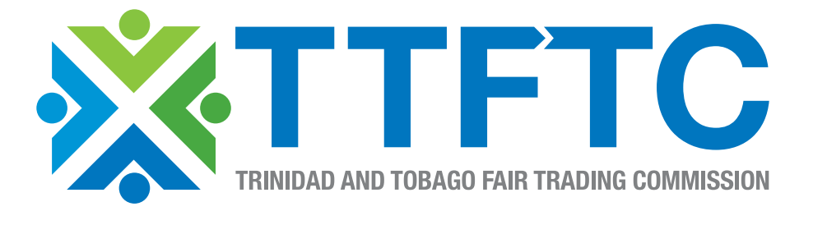
Presentation to the Standing Committee on Trade and Related Matters

Slide 2
Overview
What is Competition
Benefits of Competition
History
Fair Trading Act
About the Commission and our work
International Agreements
Commission’s Focus Areas
Advice
Final Thoughts

Slide 3
What is Competition
A situation in a market in which firms or sellers independently strive for buyers’ patronage in order to attain a particular business objective, in most cases profit, market shares, and/or sales (OECD 1993:22)
Increased competition is an important way for firms to grow to efficient sizes

Slide 4
Competition and Competitiveness
Competition is an important driver of competitiveness as it encourages entrepreneurial activities and market entry
Effective Competition policy and law can promote competitiveness and an economy’s growth prospects and can work with other complementary policies and strategies to enhance trade and investment and resource mobilization

Slide 5
History
Competition policy was introduced in Trinidad and Tobago, as part of the Economic Reform of the early 1990s and was intended to serve as a complement to other policies geared towards trade and market liberalization
Fair Trading Act was passed in 2006
Fair Trading Commission established in 2014

Slide 6
The Fair Trading Act
The Fair Trading Act creates an institutional framework for the enforcement of competition policy in Trinidad and Tobago and deals with many major issues including:
the abuse of monopoly power (dominant position is defined as controlling more than 40% of the market)
anti-competitive mergers
anti-competitive agreements and
The enforcement of the relevant clauses or enforcement measures.
Parts II, IV, V, VI, VIII have already been proclaimed
Specific anti-competitive practices that are prohibited under the Act include resale price maintenance, price fixing, collusion and cartels and bid rigging
The Act is of general application. There are however certain sectors where the Act does not apply including:
Securities Industry
Telecoms
Banking Industry
Intellectual Property
Professional Associations/Collective Bargaining Situations

Slide 7
The Commission
Independent Statutory Body
Our main purposes are to:
(i) promote and maintain effective competition throughout the economy, and to ensure that competition is not distorted, restricted or prevented
(ii) ensure that all legitimate business enterprises have an equal opportunity to participate in the economy
(iii) prevent anti- competitive conduct while at the same time complementing policies that promote competition
(iv) take action against anti-competitive practices

Slide 8
Powers
Our powers include the power to
carry out investigations
summon and examine witnesses
to call for, require the production of and examine documents in connection with an investigation and
to direct an enterprise to take such steps as are necessary and reasonable.
The Commission can take to Court any business or individual who has been found guilty of anti-competitive practices and has failed to take corrective measures

Slide 9
Court’s Enforcement Powers
prohibit an agreement from being made or carried out
order that an agreement be terminated or modified
prohibit any extraneous conditions being attached to transactions
prohibit the acquisition of another company or require that certain undertakings be entered into
Impose Fines (up to 10% of annual turnover)

Slide 10
CARICOM-Costa Rica FTA
Standing Committee on Anti-competitive business practices established to monitor the implementation of the provisions of the Agreement
There is a short Competition Policy Chapter i.e. Chapter 5
The Parties agree to make an effort to establish mechanisms to facilitate and promote the development of competition policy and to guarantee the application of regulations on free competition in and between the Parties
This may involve adopting a more elaborate Competition Policy Chapter and Work Program in the near future.
Costa Rica has an established competition law framework in place with a national competition agency (COPROCOM) established in 1996

Slide 11
CARICOM-Dominican Republic FTA
Committee on Anti-Competitive Business Practices (Article XIV)
Annex I, Article XI Anti-Competitive Business Practices as it relates to Goods
Annex II, Article XVII, Anti-Competitive Business Practices as it relates to Services
Procompetencia is the name of the Dominican Republic’s Competition authority and was established in 2008

Slide 12
Economic Partnership Agreement between the CARIFORUM States and the European Community
Article 126- Principles
The Parties acknowledge that anti-competitive business practices have the potential to distort the proper functioning of markets and the benefits of trade liberalisation
Article 127- Implementation
The Parties shall ensure that within five years of the entry into force of this Agreement they have laws in force addressing restrictions on competition and have established a Competition Authority
Article 128- Exchange of information and enforcement cooperation
Any Competition Authority may inform the other Competition Authorities of any information it possesses which indicates that anticompetitive business practices are taking place in the other Party's territory
Article 130- Cooperation
The Parties agree on the importance of technical assistance and capacity-building and agree to cooperate, including by facilitating support

Slide 13
Revised Treaty of Chaguaramas
Article 169 Objectives of Community Competition Policy
The goal shall be to ensure that the benefits expected from the establishment of the CSME are not frustrated by anti-competitive business conduct
Article 170 Implementation of Competition Policy
The Member States shall take the necessary legislative measures to ensure consistency and compliance with the rules of competition and establish and maintain institutional arrangements and administrative procedures to enforce competition laws
Article 171- Establishment of a CARICOM Competition Commission
The Commission may, make determinations or take action to inhibit and penalise enterprises whose business conduct prejudices trade or prevents, restricts or distorts competition within the CSME

Slide 14
Other Trade Agreements
No Competition Chapters in the signed Partial Scope Agreements between Trinidad and Tobago and Panama, Colombia and Venezuela nor the still in progress Agreements with Guatemala and El Salvador
Competition was one of the ‘Singapore’ issues on the WTO Agenda however there have been no material developments in this area
There was a Competition Chapter during the FTAA negotiations that have now been stalled

Slide 15
Commission’s Focus Areas
Continued Staff Recruitment
Continued Stakeholder-focussed Presentations
Entering into MOUs with other Regulators nationally, regionally and internationally
Starting a public awareness campaign focussed on the benefits of competition

Slide 16
Advice to Stakeholders
Don’t discuss prices with competitors
Don’t agree with competitors to restrict or increase levels of production
Don’t divide customers, markets or territories with competitors
Don’t require a customer to buy products only from you unless you get advice and approval from legal counsel
Don’t agree with competitors to boycott suppliers or customers
Don’t use one product as leverage to force or induce a customer to purchase another product without consulting legal counsel
Don’t cover up wrongdoings, report it immediately to legal counsel or to the Commission

Slide 17
Final Thoughts
Competitive markets can and do contribute to productivity, cost efficiency, low prices, innovation and therefore economic growth
Try to ensure that your practices are in accordance with the legislation
The TTFTC has a responsibility to do as much as possible to ensure that our policies are coherent and properly communicated.

Slide 18

Thank you for your attention!
Email: tandtftc@gmail.com

