Slide 1
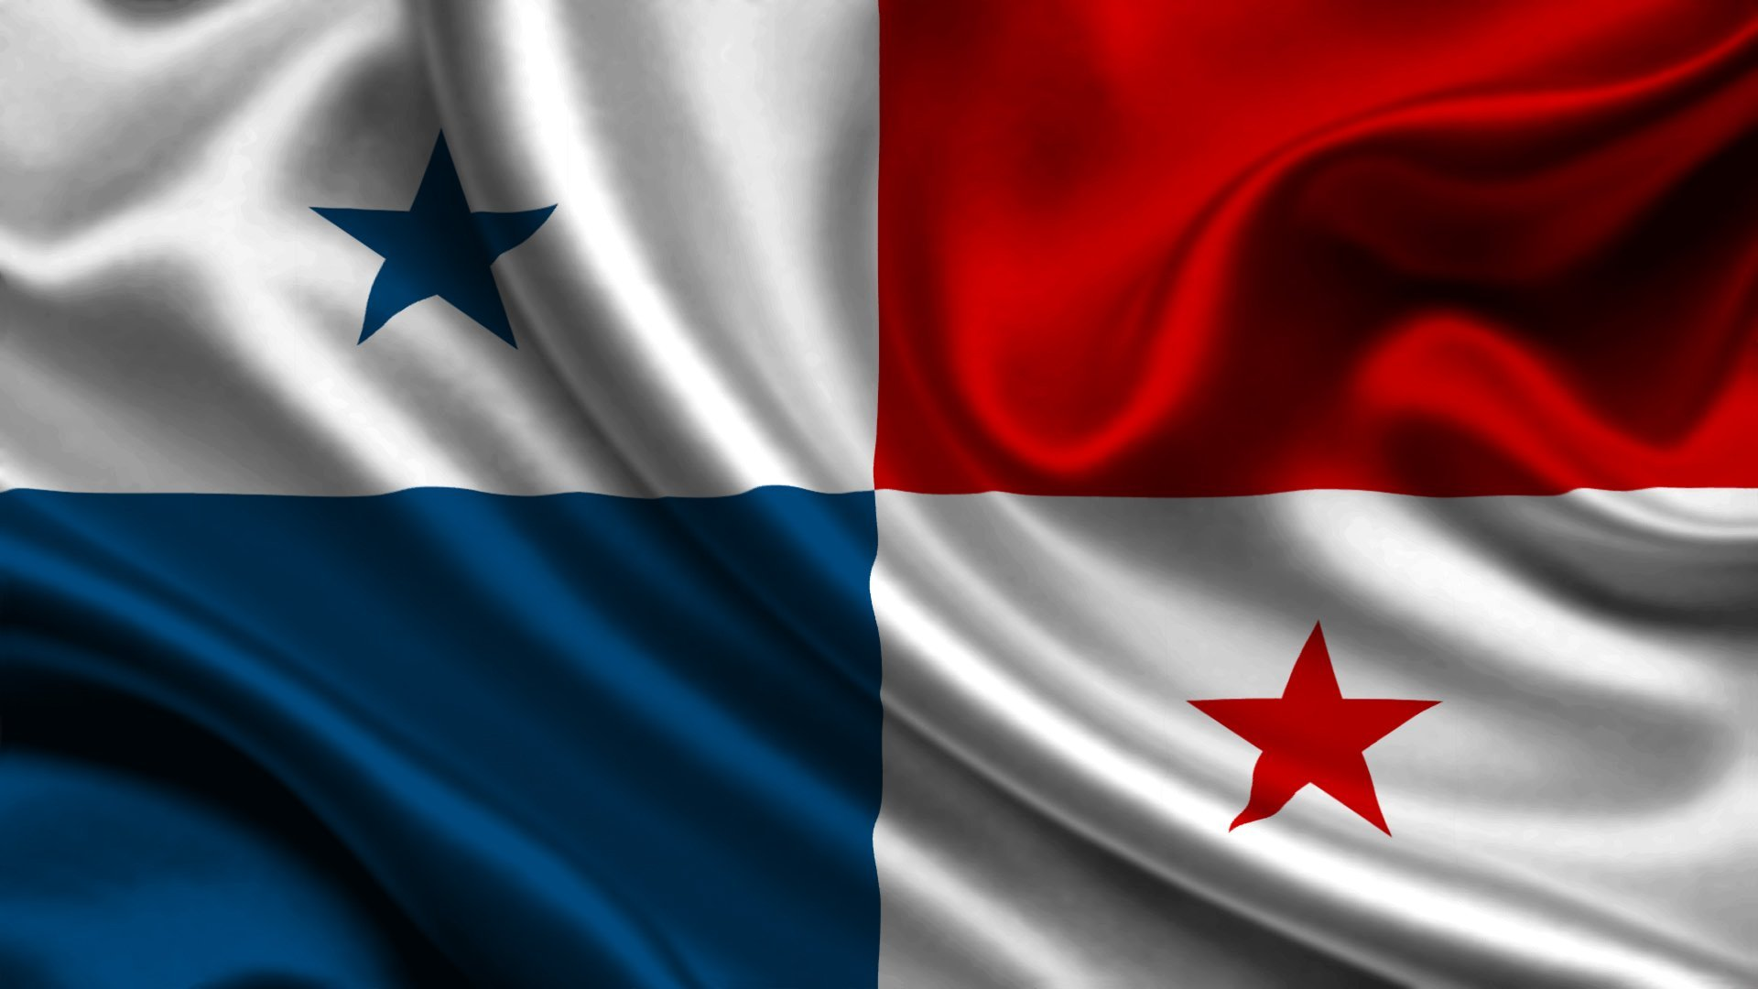
PANAMA MARKET SURVEY FINDINGS
Presented By: Vincent Ramlochan
Research Officer
Date: 24th May, 2018
Notes:
For anyone WHO HAS ATTENDED ANY SEMINAR WHEN I HAVE PRESENTED BEFORE WILL KNOW THAT I LIKE TO START MY PRESENTATION WITH THE PRICE OF A BARREL OF OIL AS AT TODAY’S DATE
Price of oil is approximately 45$ VS 120$
This one figure can clearly show the important role of exportt in assisting manufacturers in penetrating new markets to earn the much needed foreign currency.
This also shows the importance of this market survey mission and this information dissemination seminar to assist exporters in better understanding the panama market and understanding the most effective way to enter the successful penetrate the market.

Slide 2
PANAMA’S TRADE AGREEMENTS
Panama has more trade agreements than any other Central American country.
20 Trade Agreements
Canada, USA, Mexico,
Guatemala, Nicaragua, Costa Rica, El Salvador, Honduras,
Colombia, Peru, Chile, ALADI,
Cuba, Dominican Republic, Trinidad and Tobago,
EU, EFTA,
Taiwan, Singapore
South Korea and Israel **** Currently under negotiations****
Panama has cut ties with Taiwan and forged relations with China
On 7th July 2015, Decreto De Gabinete No 17 was approved
Notes:
Number of Trade Agreements
Panama 20
Costa Rica 12
Honduras 10
El Salvador Guatemala and Honduras 9
Belize 2
ALADI member countries are Argentina, Bolivia, Brazil, Chile, Colombia, Cuba, Ecuador, Mexico, Paraguay, Peru, Uruguay and Venezuela,
The EU countries are:
Austria, Belgium, Bulgaria, Croatia, Republic of Cyprus, Czech Republic, Denmark, Estonia, Finland, France, Germany, Greece, Hungary, Ireland, Italy, Latvia, Lithuania, Luxembourg, Malta, Netherlands, Poland, Portugal, Romania, Slovakia, Slovenia, Spain, Sweden and the UK.
The European Free Trade Association (EFTA) is an intergovernmental organisation set up for the promotion of free trade and economic integration to the benefit of its four Member States: Iceland, Liechtenstein, Norway, Switzerland.
If you check the number of agreements above you will realise that there are 21 agreements
Panama has cut ties with Taiwan and forged relations with China. Panama’s reversal may be linked to China’s massive investment in the country. Beijing has spent billions of dollars in the area around the Panama Canal.
Feedback from distributors is that they are waiting anxiously awaiting for a trade agreement to be signed with China to allow preferential access to the market. It is important to note that China is one of the main suppliers to Panama as we will see in the upcoming slides.
On 7th July 2015, Decreto De Gabinete No 17 was approved and it increased duties on a specific list of imported products such as:
Vienna Sausages from 10% to 30%
Ketchup 30% to 50%
Protectionism policies will NOT apply to countries that have Trade Agreements with Panama ONLY if that product was previously negotiated under the agreement

Slide 3
TRADING ENVIRONMENT-OVERVIEW
In the 2017 Ease of Doing Business Rankings Panama ranked 79th
Panama’s total non-energy imports for 2016 valued US$ 17,191,180,000
Panama’s total non-energy imports experienced declining growth of approximately 15% in 2016 when compared to 2012

Slide 4
PRODUCT REGISTRATION PROCESS
Notes:
There are two agencies in panama who deals with the product registration:
Aupsa
Ministry of Health
Product registration has been an area of great concerns for most exporters trying to Penetrate the Panama market. The next few slides will go through the process and product registration requirements.

Slide 5
AUPSA
Food and Beverage and Supplements
Cost of product registration = FREE
Time taken to register products = 20 days
How to register the product = distributor or attorney
Type of process = Online
Exporters must have a distributor to be able to begin the process
No limit on the number of products to be registered at a time
Notes:
The product registration process has been seen as one of the major challenges facing our local exporters in T&T

Slide 6
AUPSA
Information required
Description of the products e.g. chocolate biscuit
Description of how the product is manufactured
Ingredients – same as shown on the label, allergens must be included
No, Y Nombre De Planta Procesordor – include SN and SP if the product does not contain any plant or meat products
Manufacturer’s name and name of the packaging company if the process is outsourced
The complete barcode number on the product must be entered.
Notes:
Description of the products ( must be direct and to the point) e.g. chocolate biscuit
Description of how the product is manufactured ( must be direct and to the point)
Ingredients – same as shown on the label, allergens must be included such as soy, eggs, gluten, milk, nuts etc.
No, Y Nombre De Planta Procesordor – include SN and SP if the product does not contain any plant or meat products
Manufacturer name and even the name of the packaging company if the process is outsourced
The complete barcode number on the product must be entered. If the product does not have a bar code there is an area to explain the reason for this

Slide 7
DOCUMENTS REQUIRED
Free Sale Certificate
Formula of Product
Detailing Manufacturing Method
Notification System
Biological stability of the product
All documents must be submitted in PDF, JPEG, the following file types are not recommended: TIF, WORD, EXCEL
Files should not be larger than 2MB
https://www.youtube.com/watch?v=uF7CheDEgqc
Notes:
Free Sale Certificate – that is issued by the sanitary agency in T&T and must have the consulate stamp or apostle. The original free sale certificate must be sent to the distributor stamped by the Panamanian consulate which must then be taken the Ministry of External Relations in Panama. *** The apostle process is the fastest method***
Formula of product- which will be entered as a percentage of the total product
Detailed manufacturing method- which is a step by step detailed description of the process
Notification system- this includes the expiration date and production dates including batch number, time etc. ** The format for the date must be explained e.g. day/month/ year or month/day/ year etc.
Biological stability of the product- includes a shelf life certificate and explanation of the type of test completed
There is no exclusive ownership of the registration if it is done by a distributor.
If at some point the exporter wants to change distributor he/she can because the product is already registered and the distributor who filed for the registration does not own it.
If the exporter decides to change distributor an email must be send to AUPSA and the new distributor must contact AUPSA ( lawyers can assist in drafting these letters)

Slide 8
Ministry of Health
Products that come into contact with the skin e.g. cosmetics, cleaning chemicals, insecticides etc.
Cost of product registration = US$260 per product for a 5 year period
Time taken to register products = 2 months
How to register the product = attorney
Type of process = Manual
All documents must be submitted in Spanish
A max of 10 products with similar formulation can be placed on the same document
Notes:
The process must be done through the power of an attorney but the T&T company must be stated as the requesting company for the sanitary registration
The power of attorney must provide a certificate from both a Panamanian and T&T Chemist ( Chemistry Food and Drug)
There is an Association of Chemist in Panama who has a listing of authorized chemist that companies can use.
For the renewal of the sanitary registration the documents and process will remain the same unless some alternations were to the product and you must start a new registration.
The process is manual and all documents must be dropped off in person at the MOH
All documents must be submitted in Spanish
Any document submitted in English must be translated and stamped by a registered Panamanian translator which is usually handled by the attorney
If products carry the same formula but differs with regard to colour and scents the MOH will allow max of 10 products on the same form at one cost but if the percentage in the formula is not the same each product must be done separately
Possible reasons for delays in the process
Missing documents
Information are not matching from translated documents
If the use of the product is not specifically stated especially for products with multiple uses
Any prohibited ingredients

Slide 9
DOCUMENTS REQUIRED
Original or legalized copy of the legal entity of the registrant company
Power in favour of the legal representative. If the document is granted abroad, it must be legalized.
Certificate of free sale, good manufacturing practices or certification of the manufacturer laboratory (foreign products). The same must be in Spanish and authenticated.
Safety sheet (Material Safety Data Sheet, MSDS) Must be in Spanish
Qualitative and quantitative formula
Specifications of the finished product in original and copy of the physical-chemical and microbiological specifications ( toxicological information)
Two copies of the physical-chemical analysis method used by the manufacturer to analyse the product
Copy of the Sanitary Permit of Operation
Four Intact Product Samples
Proof of payment
Notes:
Original or legalized copy of the legal entity of the registrant company
Power in favour of the legal representative. If the document is granted abroad, it must be legalized.
Certificate of free sale, good manufacturing practices or certification of the manufacturer laboratory (foreign products). The same must be in Spanish and authenticated.
Safety sheet (Material Safety Data Sheet, MSDS)
Qualitative and quantitative formula signed by the responsible professional.
Specifications of the finished product in original and copy of the physical-chemical and microbiological specifications
Two copies of the physical-chemical analysis

Slide 10
HEALTH DOCUMENTS FOR EXPORTING TO PANAMA
AUPSA
The importer must provide AUPSA with a notification 48 hours before the products arrival
Documents required at ports for AUPSA
Free Sale Certificate
Sanitary Certificate
MINISTRY OF HEALTH
Documents required for signature by Ministry of Health
Pre-declaration form
Invoice
Sanitary registration

Slide 11
PRODUCTS THAT DO NOT REQUIRE A SANITARY REGISTRATION NUMBER
Paper products ( napkins, hand towels, tissue paper)
Construction materials
Food boxes ( must have something stating it is safe for food use)
Notes:
Paper products ( napkins, hand towels, tissue paper)
Construction materials
Food boxes ( must have something stating it is safe for food use)

Slide 12
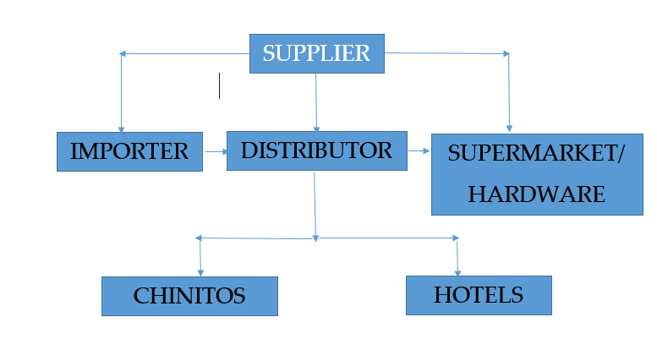
DISTRIBUTION CHANNEL
10%
30-35%
25-30%
10-15%
Notes:
During the visit exporTT met with all the persons along the distribution channel to provide a comprehensive review of the market. We are currently in the process of confirming an importer for a very important visit to meet with T&T manufacturers as early as next 2 weeks
Understanding the different cost that are associated with selling to different members along the distribution channel and how business purchase
Hotels do not buy directly from suppliers but prefer to purchase from distributors due to convenience and ease
Food service buyers directly from distributors locally however some are interested in any opportunities to import. We met with the largest fast food chain which is Pio Pio which is part of Grupo Melo and has two other smaller chains under which are Breados and

Slide 13
RETAIL LANDSCAPE

Slide 14
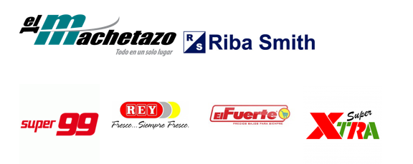
GROCERY RETAILERS IN PANAMA
Leading Grocery Retailers
El Machetazo
Riba Smith
Super 99
El Fuerte
Super Xtra
El Rey
Other Major Retailers
Pricesmart (5)
Notes:
EL Rey- the company has a total of 29 Reys currently but at the end of the year the total will be 31.
Mr Precio which caters to the lower income earners which has a total of 10 branches
Metro- which caters to high income earners with a total of 25 branches
Romero which caters to the middle income earners and is located in different provinces in Panama with a total of 11 branches
Super 99 which has 46 stores
Range of products are impressive, not simple basic products such as:
Mayo in a variety of flavours and not just light and egg less oil, olive, lime
Bleach with different scents
The shelf space is large for these products compared to the basic generic products….. Product innovation is very important especially in food and beverage as many products are competing for the same shelf space. This was echoed by many distributors when asked what products they are interested in or currently sourcing.
All supermarkets have a cost attached to shelf space for every brand and every size and distributors are asking suppliers to absorb this cost.
Supermarket Margin = 25%- 30%
Supermarkets usually ask for a 90 day credit vs “chinitos” who usually pays cash on delivery.
The shelf space cost is an initial one-time payment
Private label brands

Slide 15
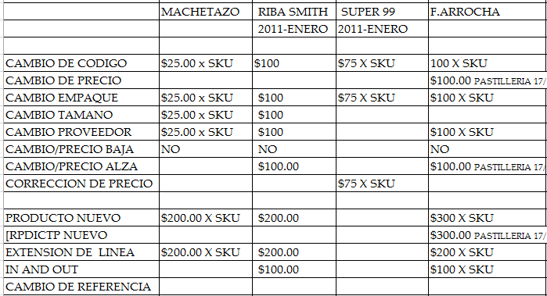
COST OF SUPERMARKET ENTRY
Notes:
Super 99 has 46 stores
Super 99 is difficult because distributors must provide for a certain quantity of products “ trail order” for each branch of the supermarket to see if the products are viable before Super 99 makes an order

Slide 16
CHINITOS
Down trade in Panama
Turnover is high ( purchase on a daily basis)
Product sizes are small
Notes:
Chinitos are known by different names in different countries such as mom and pop shops, colmados, palour
These mom and pop shops represents the down trade in Panama. As the name states it is own and operated by Chinese and caters to customers that are buying products on a daily basis. In this regard, product sizes are much smaller when compared to the sizes sold by the major supermarket chains.
It is important to note that chintos carry not only food products but construction material products as well

Slide 17
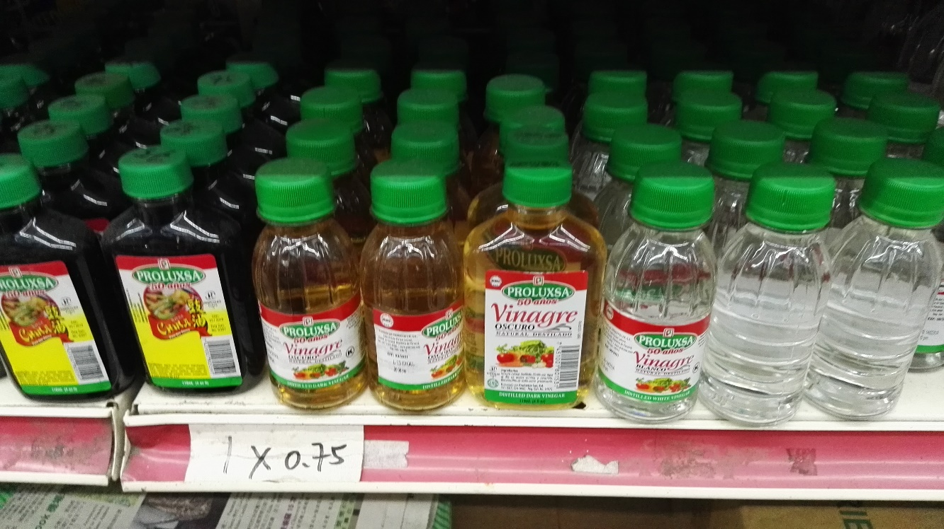
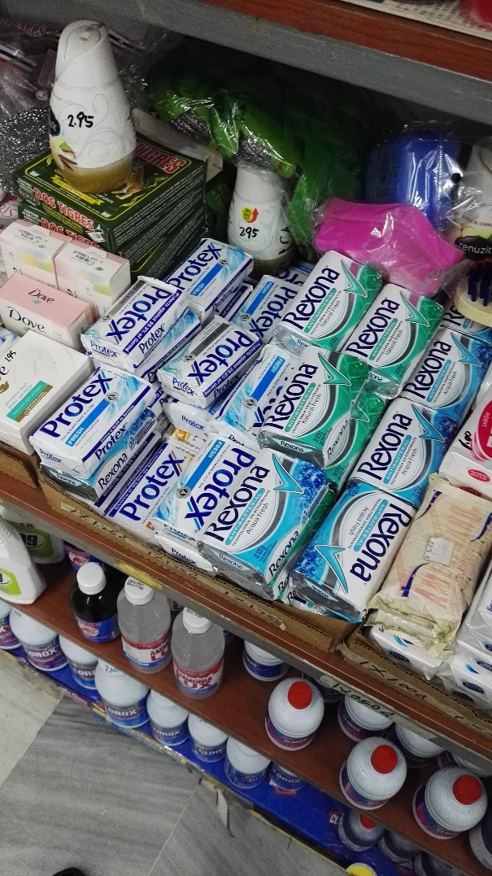
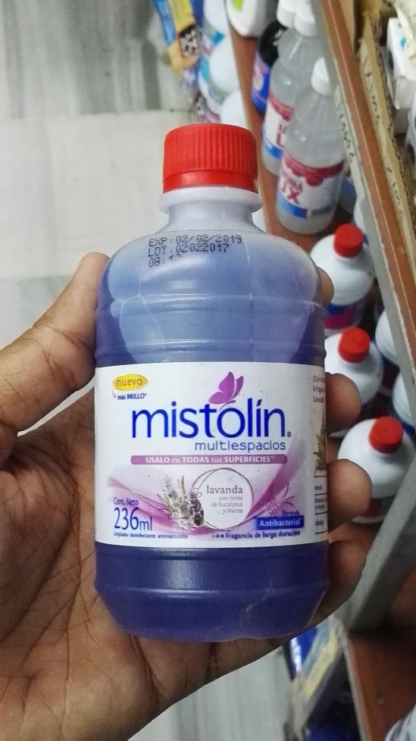
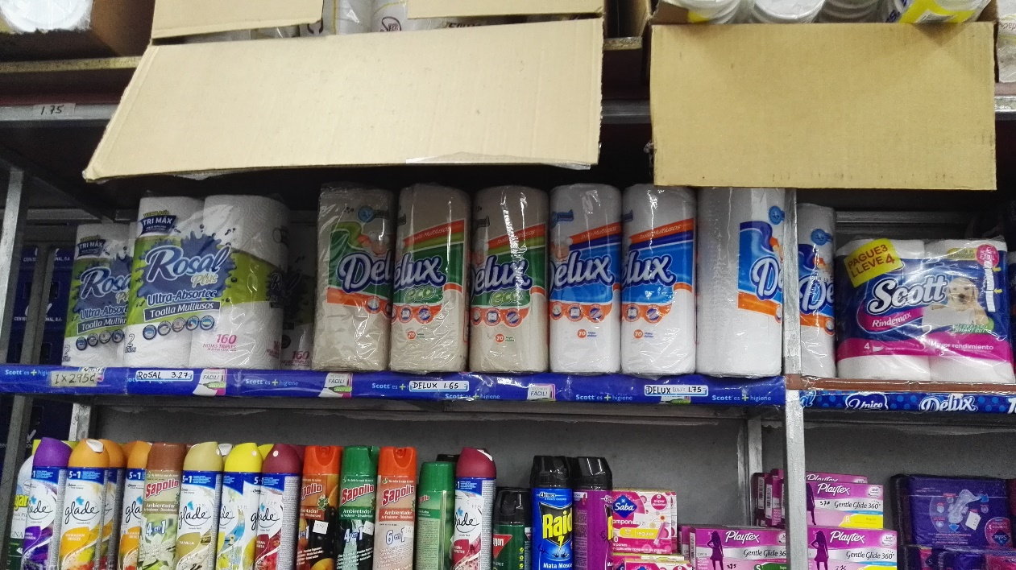

Slide 18
HARDWARE STORES
Leading hardware stores
Do it Centre
Novey
Cochez
Rodelag
Hopsa
Main suppliers of construction materials include:
China, USA, Free zone, Costa Rica, Colombia and Mexico.
Notes:
During our visit we were able to have meeting Cochez, Novey, Rodelag and Hopsa
Cochez has 22 stores and their customers are contractors for construction projects, electricity etc.
Novey - has 21 stores and their customers purchase for do it yourself home projects and decorations. This company is similar to Do it Centre
Cochez and Novey together provide the service where they build and decorate your home.
Cochez and Novey are both owned by the same company, with Cochez targeted to contactors and special products and Novey caters to a more “do it yourself” household projects.
Distributor margins 30%
Some locally manufactured construction products include:
Paints Pintuco
PVC pipes and fittings
Main suppliers of construction materials include: China, USA, Freezone, Costa Rica, Colombia and Mexico.

Slide 19
DISTRIBUTORS
There is NO distributor law in Panama
Credit terms = 60 to 90 days
Product range is important
Many distributors outsource their logistics operations
Differentiated products (unique, eco, green)
Notes:
I know this is a major area of concerns for most companies in T&T when seeking to do business though a distributor but unlike countries like DR Panama has no distributor law. I will leave this topic for Sr Almanza who will share greater insight on this.
After meeting with over 20 distributors the average credit terms being requested by distributors ranges between 60 to 90 days. It is important to put this into perspective as supermarket and hardware store chains ask for a credit period of 90 days to 120 days from distributors. When compared to the chinitos who usually pay cash on delivery
This is an area as well that is very important to companies. However panama is not like other countries were distributors purchase a large fleet of trucks to cover their distribution. This is usually outsourced due to the cost. I am not saying this is done by all distributors but approximately 80% of distributors use this method. While others use a mix of both in-house logistics and outsourced.
Recycled paper is a major trend and is being used in restaurants etc, unquie products something that is different because many products competing for the same shelf space.

Slide 20
PRIVATE LABELLING
Private labelling is very popular and growing trend in Panama
Distributors carry their own private label brands
No difference between private label and branded products
Notes:
It is very common for supermarket chain and hardware store to carry private label brands but what was interested to me was the number of distributors that carry their own private label brands. Some distributors such as Rodolfo Moreno, Brands and Products,
No difference between private label and branded products trying to not compete on quality and not jus price

Slide 21
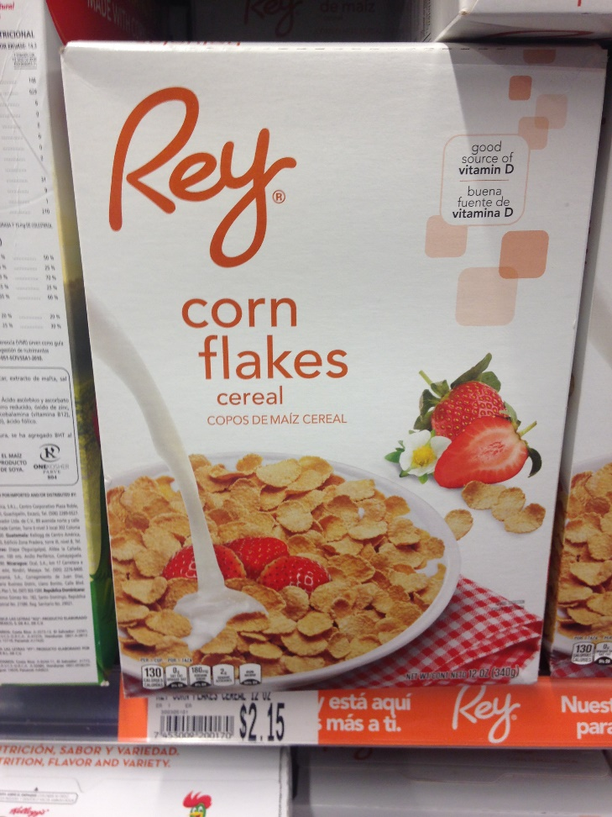
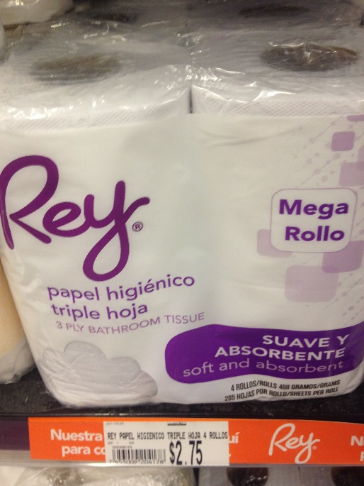
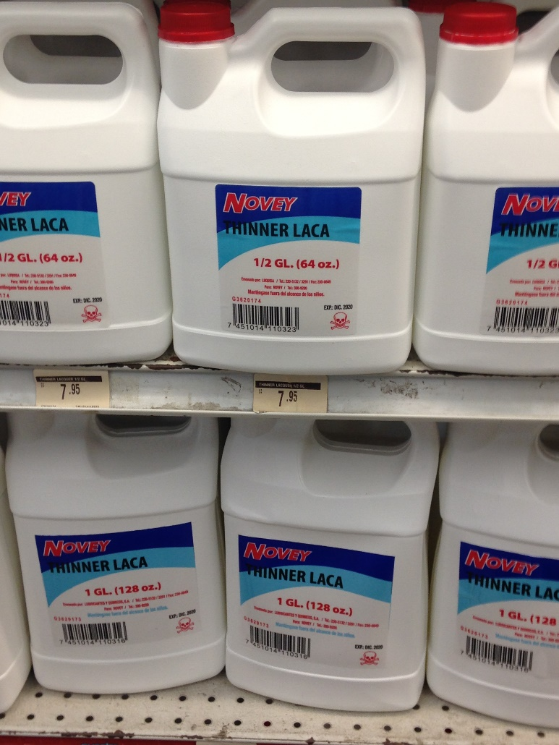
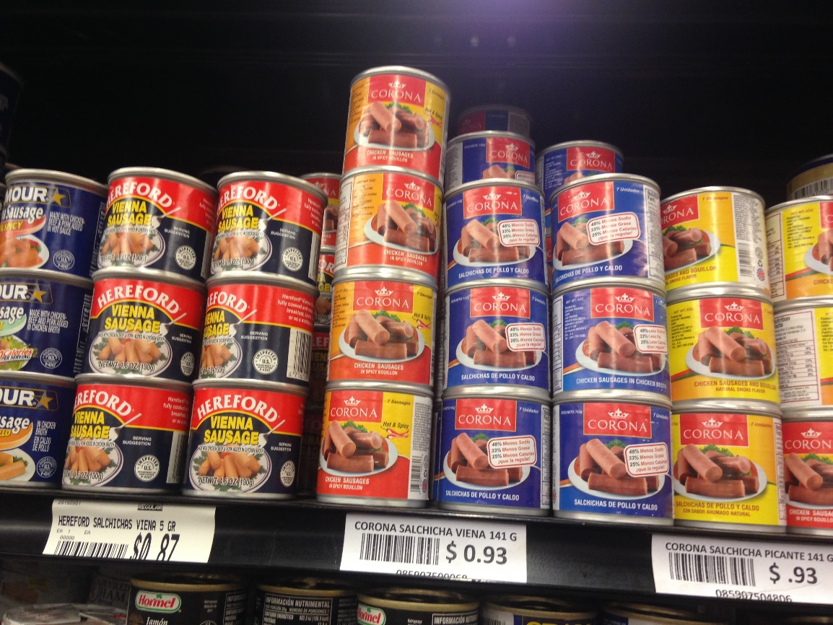

Slide 22
MARKET ENTRY REQUIRMENTS

Slide 23
Packaging and Labelling Requirements
Currently there are no packaging laws in Panama.
Currently, Panama is basing their packaging and labelling regulations on the CODEX STAN 1-1985 international system. http://gacetas.procuraduria-admon.gob.pa/27842-A_2015.pdf
Product labels for non-food products must follow RTCA 855 ED 4th August, 2015.
Labels can be printed in Spanish or English although Spanish is preferred
Notes:
There is no labelling law in Panama, there has been a number of meeting to change the law but to date nothing has been decided. However, the distributor is currently trying to protect himself from any changes in the law and is including the following on labels:
Sanitary registration
Name of distributor
Address
Email
Ingredients
Where the product is made

Slide 24
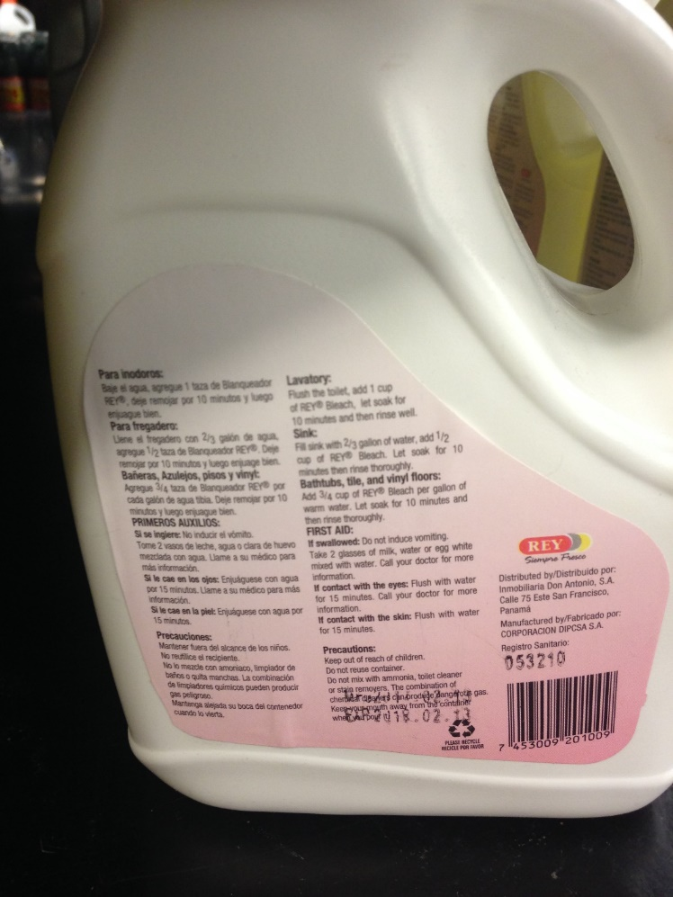
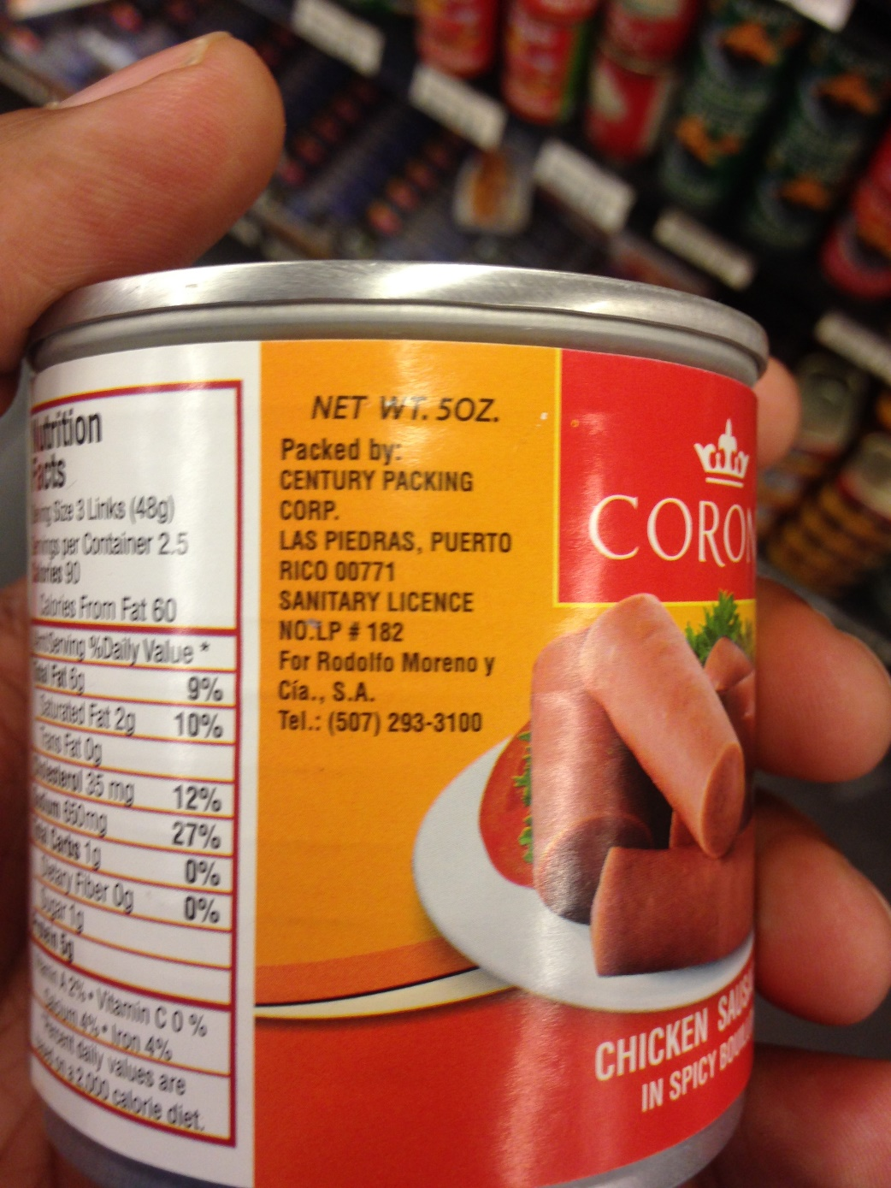
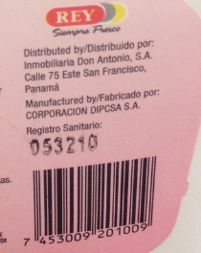
Notes:
There is no labelling law in Panama, there has been a number of meeting to change the law but to date nothing has been decided. However, the distributor is currently trying to protect himself from any changes in the law and is including the following on labels:
Sanitary registration
Name of distributor
Address
Email
Ingredients
Where the product is made

Slide 25
KEY CONSIDERATIONS
Upcoming Negotiations with China
Duties for products not included in the agreement
Additional cost of selling to supermarkets
Differentiated product (eco, green, unique)
Product Registration Process
Language Barrier

Slide 26
THANK YOU Vincent Ramlochan Research Officer vramlochan@exportt.co.tt 468-6842

