Slide 1
PARTIAL SCOPE TRADE AGREEMENT BETWEEN TRINIDAD AND TOBAGO AND PANAMA
Candice Lackhansingh
MAY 24, 2018

Slide 2
OBJECTIVES
Trade Statistics
Details of the Agreement
Status of Implementation
Way forward
Notes:
The following slides show several examples of timelines using SmartArt graphics.
Include a timeline for the project, clearly marking milestones, important dates, and highlight where the project is now.

Slide 3
Exports to Panama (2010-2016)
Top Ten Products Exported to Panama in 2016
 | Product Code | Product Description | Value | Percentage of Total Exports to Panama
1. | 27101220 | MOTOR SPIRIT | TT$58, 165, 254.00 | 34%
2. | 48030020 | TOILET OR FACIAL TISSUE STOCK, IN ROLLS OR SHEETS. | TT$34, 001, 079.05 | 20%
3. | 27111300 | LIQUIFIED BUTANES | TT$33, 431, 351.08 | 20%
4. | 31021000 | UREA | TT$7, 716, 939.65 | 5%
5. | 21039050 | AROMATIC BITTERS | TT$4, 385, 390.65 | 3%
6. | 19049000 | PRE-COOKED/PREPARED FOODS FROM CEREALS NES | TT$4, 046, 811.88 | 2%
7. | 27111200 | LIQUIFIED PROPANE | TT$3, 051, 909.19 | 2%
8. | 27101950 | BUNKER `C' GRADE FUEL OIL | TT$2, 424, 858.94 | 1%
9. | 20089990 | PRES/PREP FRUIT, NUTS, EDIBLE PLANT PARTS NES | TT$2, 102 ,875.03 | 1%
10. | 27101940 | GAS OILS EXCL. DIESEL OIL | TT$1, 375, 921.97 | 1%
Total Exports to Panama 2010 to 2016
Year | Total Exports in (TT$ millions)
2010 | 1, 026. 22
2011 | 353.37
2012 | 512. 59
2013 | 1, 183. 60
2014 | 954. 56
2015 | 356. 75
2016 | 169. 07
Fall in exports of other petro oils excluding crude
Notes:
Total Exports to Panama (2010 to 2016):
From Approx TT$ 1.026 Bn in 2010 Total Exports to Panama drastically declined to approx. TT$ 353. 4 Mn in 2011. Exports gradually increased over the period 2012 to 2013 to reach it’s highest value of TT$1, 183, 604, 619.80 (Approx. TT$ 1.2 Bn). However, following this peak, Total Exports to Panama declined over the period 2014 to 2016. In 2016, it reached its lowest value for the overall period of TT$169, 064,496.46 (Approx. TT$ 169 Mn).
Top Ten Products Exported
Motor Spirit
Toilet & Facial Tissues
Liquefied Butanes
Urea
Aromatic Bitters
Cereals and Foods prepared from Cereal
Liquefied Propane
Bunker C Grade Fuel Oil (Marine Gas Oil)
Preserved/Prepared Fruits, Nuts and Edible Parts of Plants
Gas Oils excluding Diesel

Slide 4
Imports from Panama (2010-2016)
Top Ten Products Imported from Panama in 2016
 | Product Code | Product Description | Value | Percentage of Total Imports from Panama
1. | 30049090 | OTHER MEDICAMENTS, THERAPUTIC/PROPHYLATIC USES; MEASURED DOSES | TT$30, 277, 155.51 | 21%
2. | 20099090 | OTHER MIXTURES OF JUICES NES | TT$11, 581, 512.82 | 8%
3. | 02023090 | OTHER BONELESS BOVINE FROZEN | TT$10, 194, 169.26 | 7%
4. | 21069090 | OTHER FOOD PREPARATIONS N.E.S. | TT$7, 440, 422.40 | 5%
5. | 03038310 | FROZEN TOOTHFISH FOR PROCESSING | TT$6, 533, 117.38 | 4%
6. | 16023290 | OTHER PREP. OF FOWL | TT$4, 817, 627.59 | 3%
7. | 30042090 | OTHER MEDICAMENTS CONTAINING OTHER ANTIBIOTICS NES; MEASURED DOSES | TT$3, 939, 684.22 | 3%
8. | 33021020 | PREP. ON ODORIFEROUS SUB IN MANUF BEVERAGES | TT$2, 271, 299.04 | 2%
9. | 03038100 | FROZEN DOGFISH & OTHER SHARKS | TT$2, 151, 084.97 | 1%
10. | 84291900 | OTHER SELF PROPELLED BULLDOZERS/ANGLEDOZERS | TT$1, 946, 291.68 | 1%
Total Imports from Panama 2010 to 2016
Year | Total Imports (in TT$ millions)
2010 | 46. 957
2011 | 195. 48
2012 | 775. 784
2013 | 102. 505
2014 | 121. 293
2015 | 157. 468
2016 | 145. 369
vessels
Notes:
Total Imports from Panama (2010 to 2016):
From its lowest value of TT$ 46, 957, 639 (Approx 46 Mn) in 2010, Total Imports from Panama increased over the period 2011 to 2012, to its highest value of TT$775,784,583.12 (Approx. TT$ 775 Mn). This value in 2012 represented a 296% increase from the Value of Total Imports in 2011. However, following this peak, Total Imports experienced a 656% decline in 2013 to TT $102, 505, 804.64 (Approx TT$ 102 Mn). Over the period 2014 to 2015, Total Imports gradually increased, before falling slightly in 2016 to TT$145, 369, 476.06 (Approx TT$ 145 Mn).
Top Ten Products Imported
Medicaments for Therapeutic/Prophylactic Uses
Mixed Juices
Frozen Boneless Beef
Food Preparations
Frozen Toothfish (Toothfish, Marlin, Swordfish)
Preserved Chicken Meat (Chicken Tenders, Chicken Nuggets, Chicken Wings)
Antibiotic Medicaments in Measured Doses
Flavouring Essences for the Manufacture of Beverages
Frozen Dogfish and other Sharks
Bulldozers and Angledozers (Tractors)

Slide 5
THE TRADE AGREEMENT
A Partial Scope Trade Agreement between the Republic of Trinidad and Tobago and the Republic of Panama
Act No. 5 of 2015 to give effect to the PSTA between Trinidad and Tobago and Panama
Exchange of Instruments of Ratification
Entered into force
Signed on October 3, 2013
Assented to on April 1st 2015
June 4, 2016
July 5, 2016

Slide 6
THE PSTA BETWEEN TRINIDAD AND TOBAGO AND PANAMA
WHAT’S IN IT?
THIRTY ARTICLES
PART 1
General Provisions
PART IV
Trade in Services
PART II
Trade in Goods
PART VI
Institutional Arrangements
Joint Administration Commision
PART V
Investment
Part III
Trade Facilitation
Notes:
The PSTA contains thirty (30) articles and extends beyond Trade in Goods to also cover Trade Facilitation and Legal and Institutional Arrangements, with built-in agendas for the future negotiations of a Bilateral Investment Treaty (BIT), as well as future liberalization on Trade in Services.

Slide 7
ARTICLES – TRINIDAD AND TOBAGO AND PANAMA PSTA
1 Establishment of a Partial Scope Trade Agreement | 11. Agricultural Export Subsidies | 21. Future Liberalization
2. Objectives | 12. Bilateral Safeguard Measures | 22. Future Negotiations
3. Definitions and Interpretations | 13. Global Safeguard Measures | 23. Joint Administration Commission
4. Scope and Coverage | 14. Antidumping and Counterveiling Measures | 24. Agreement Coordinators
5. Elimination of Tariffs/Market Access | 15. Technical Barriers to Trade | 25. Dispute Settlement
6. National Treatment | 16. Sanitary and Phytosanitary Measures | 26. General Exceptions
7. Rules of Origin | 17. Customs Valuation | 27. Amendments/ Modifications
8. Import and Export Restrictions | 18. Objectives and Principles of Trade Facilitation | 28. Annexes, Appendices and Footnotes
9. Import Licensing | 19. Specific Provisions to Promote Cooperation | 29. Entry into Force
10. Consular Fees | 20. Technical Cooperation Work Programme | 30. Termination

Slide 8
OBJECTIVES OF THE PSTA
Promote through the expansion of trade in goods and services the harmonious development of economic relations between the parties
Contribute to the removal of barriers to trade
Enhance the development and expansion of trade
Strengthen cooperation activities in all areas relevant to trade
Provide fair conditions for competition
Develop mechanisms that facilitate investments
Notes:
PART 1 – General Provisions – Objectives, Definition, Scope

Slide 9
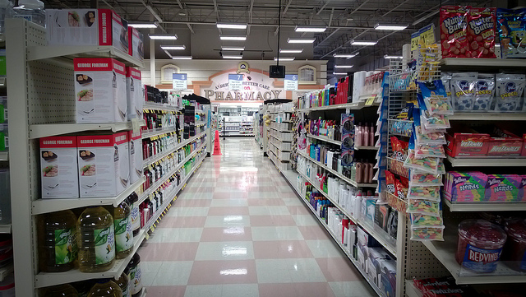
Market Access for Goods
Annex A – List of Products from Trinidad and Tobago on which Panama will grant Preferential Access (230 goods)
Annex B – List of Products from Panama on which Trinidad and Tobago will grant Preferential Treatment (248 goods)
Notes:
PART II – Elimination of Tariffs,
The PSTA provides preferential access for two hundred and thirty (230) goods from Trinidad and Tobago into Panama, and for two hundred and forty eight (248) goods from Panama into Trinidad and Tobago. The product coverage of the PSTA is wide ranging and includes beverages, dairy products, meat and fish products, seasonings, articles of clothing, wood, cement and paper products, among others.

Slide 10
Annex A – Panama will grant Preferential Access
Duty-free access for 159 products at the date of entry into force of the PSTA;
Phased reduction of duties to zero for 29 products over a period of 10 years;
25% discount on duties for 26 products; and
50% discount on 16 products.

Slide 11
Annex B – Trinidad and Tobago will grant Preferential Access
Duty-free access for 98 products at the date of entry into force of the PSTA;
Phased reduction of duties to zero for 119 products over a period of 10 years;
Phased reduction of duties to zero for 19 products over a period of 5 years;
50% discounts on 6 products; and
Seasonal duty-free access for 6 products during June-December.

Slide 12
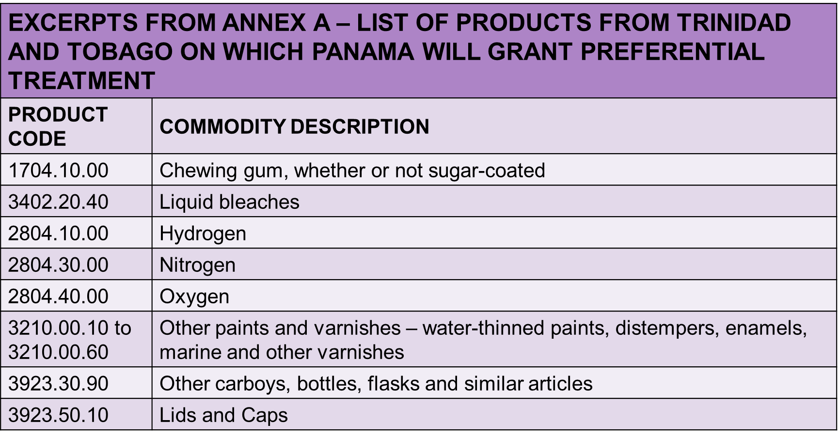
Products of Interest - Export

Slide 13
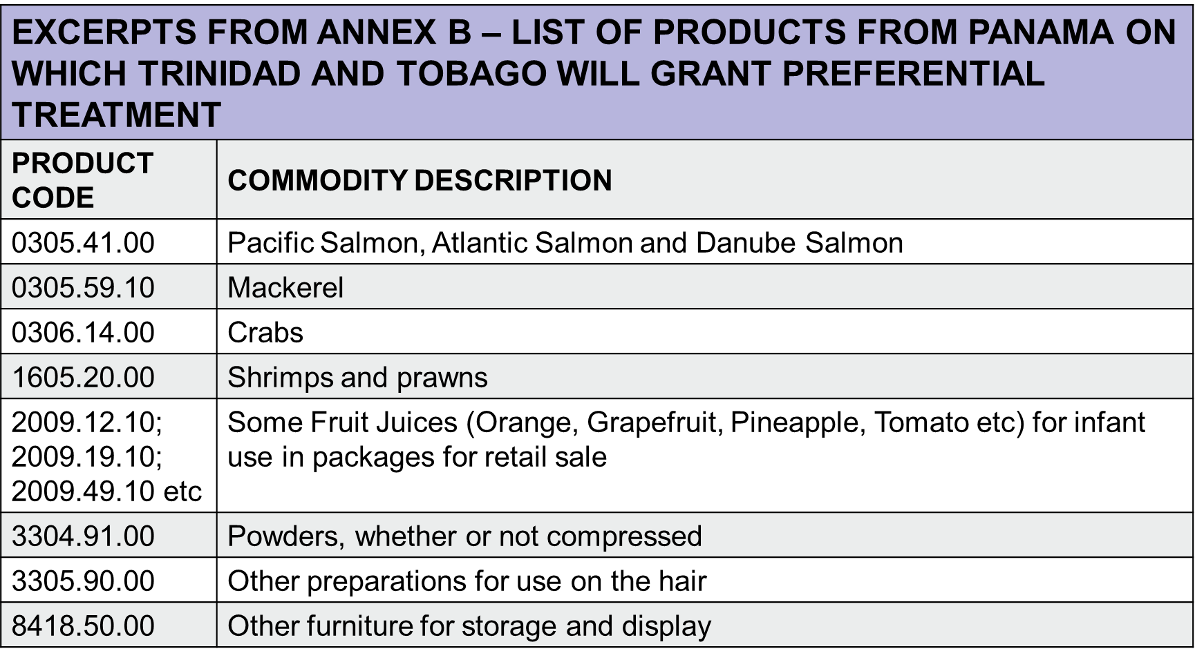
Products of Interest - Import

Slide 14

Rules of Origin
Annex C of the Partial Scope Trade Agreement
Currently two separate rules of origin
Propose a unification of the Rules of Origin
Notes:
PART II
The PSTA provides preferential access for two hundred and thirty (230) goods from Trinidad and Tobago into Panama, and for two hundred and forty eight (248) goods from Panama into Trinidad and Tobago. The product coverage of the PSTA is wide ranging and includes beverages, dairy products, meat and fish products, seasonings, articles of clothing, wood, cement and paper products, among others.

Slide 15
Trade Facilitation
Objectives and Principles Office
Technical Assistance, Exchange of Information, Best Practices
Specific Provisions to Promote Cooperation
Technical Cooperation Work Programme
Notes:
Trade Facilitation –
Pursue Trade Facilitation Initiatives
Develop import and Export procedures to share with each other
Encourage Cooperation and Technical Assistance for trade facilitation
Specific Provisions to Promote – develop a technical cooperation work programme – trade facilitation matters - issues such as scope timing and cost
Possinle areas under the technical cooperation programme – automated systems and cross border exchange – talk about interoperability
Exchange of vessel registry data
Transhipment of goods
Commercial practices

Slide 16
Trade in Services and Investment
Future Liberalization on Trade in Services – 2 Years from entry into force
List of services under Article 21 in Agreement
Future Negotiations on a Bilateral Investment Treaty
TT transmitted a draft Reciprocal Investment Promotion and Protection Agreement to Panama in February 2018
Notes:
The PSTA also provides for future negotiation of a Bilateral Investment Treaty (BIT) within one (1) year of the date of entry into force of the Agreement; services liberalization within two (2) years of the date of entry into force; and additional access for products three (3) years after entry into force.
Cabinet in June 2017 agreed that Panama would be one of the countries prioritized for the negotiation of a Reciprocal Investment Promotion and Protection Agreement of Bi-lateral Investment Treaty (BIT), as they are more commonly referred.
The Government of Panama indicated its willingness to proceed with negotiations in October 2017. Trinidad and Tobago, through the Ministry of Foreign and CARICOM Affairs transmitted it model Reciprocal Investment Promotion and Protection Agreement in February 2018 for Panama’s consideration.

Slide 17
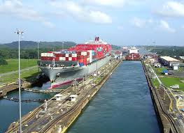
Joint Administration Commission
Supervise the Implementation and Administration
Review the General Functioning of the Agreement
Instruct and supervise the work of all bodies ( committees/working groups) established and adopt decisions
Resolve disputes
Recommend Amendment/s or Modification/s
Meet Annually
Notes:
PART II
The PSTA provides preferential access for two hundred and thirty (230) goods from Trinidad and Tobago into Panama, and for two hundred and forty eight (248) goods from Panama into Trinidad and Tobago. The product coverage of the PSTA is wide ranging and includes beverages, dairy products, meat and fish products, seasonings, articles of clothing, wood, cement and paper products, among others.

Slide 18
Process to convene
Joint Administration Commission
Determine Agenda
Meeting Logistics
Convene Meeting
Agreement Coordinators

Slide 19
Draft Agenda -Joint Administration Commission
Commitments Under the Agreement
  Transposition of Tariff Lines in Annexes A and B
  Development of Technical Cooperation Work Program – Article 20
  Dispute Settlement Provisions – Establishment of Arbitral Roster – Annex D Section V
Amendment to Appendix I to Annex C (Unification of Rules of Origin)
Negotiation of Built-In Agendas
  Bilateral Investment Treaty – Article 22
  Future Liberalization on Trade in Services – Article 21
Technical Barriers to Trade – Article 15
Sanitary and Phytosanitary Measures – Article 16
Negotiation of New Products for Inclusion in Annexes A and B
Private Sector Dialogue between Trinidad and Tobago and Panama

Slide 20
Status of Implementation
Implementation Plan Approved
Agreement Coordinators appointed
Meetings conducted with Individual Stakeholders
Rules of Origin
TBT Notifications List Prepared by TTBS
Preparations for the convening of the JAC

Slide 21
WAY FORWARD
Utilization of the Existing Agreement
Transposition of the Agreement from HS 2007 – HS 2017
Submission of Challenges
Submission of New Products for Additional Preferential Access

Slide 22
Contacts
Mr. Trudy Lewis
Senior Economist
Ministry of Trade and Industry
Tel: 623 2931 ext. 2410
Email: lewist@gov.tt
Mrs. Candice Lackhansingh
Programme Coordinator
Trade Implementation Unit
Ministry of Trade and Industry
Tel: 623 2931 ext. 2429
Email: lackhansinghc@gov.tt
exporTT
Tel: -623-5507
TTMA
Tel: 675 8862

